Slide 1
Global COVID-19 Clinical Data Platform
November 2020
Soe Soe Thwin, MS, PhD
Manager - Biostatistics and Data Management
Dept of Sexual and Reproductive Health and Research, WHO

Slide 2
Agenda
ITEM | TRAINER | MINUTES | CONTENT
PART I. CLINICAL COMPONENT
1 | Silvia Bertagnolio | 30 | Platform Overview and CRF-CORE, and CRF MIS-C
2 | Caron Kim | 10 | CRF-P
4 | Q&A | 10 | Q&A on content
PART II. TECHNICAL COMPONENT
5 | Soe Soe Thwin | 5 | Overview of data processing and management
6 | Firdavs Kurbonov | 20 | Instruction manual for accessing and entering data into the COVID clinical data platform
7 | Q&A | 10 | Q&A on technical
8 | Trainees | 15 | Hands on access with temporary credentials

Slide 3
WHO Data Management Team
Soe Soe Thwin
Firdavs Kurbonov
Ronaldo Silva
Saidou Kouyate Mohamed
- - - - - - - - - - - - - - - - - - - - - -
Khurshed Nosirov
Sihem Landoulsi
Data platform
Data Curation
Data Analytics (EPI team)

Slide 4
WHO Website Link:
https://www.who.int/teams/health-care-readiness-clinical-unit/covid-19/data-platform
OpenClinica Logon Link:
https://who.eclinicalhosting.com/OpenClinica/pages/login/login
OpenClinica Instructons:
https://www.who.int/docs/default-source/documents/emergencies/instructions-to-upload-clinical-data-global-covid19-data-platform.pdf?sfvrsn=9f6b6d18_2

Slide 5
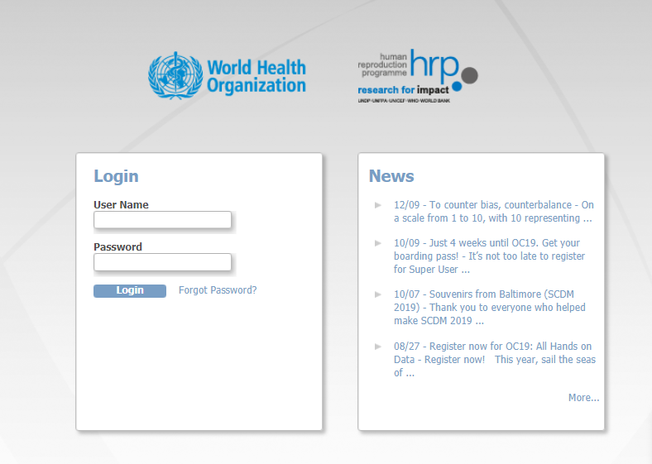
Electronic Data Capture (EDC) Platform
EDC platform, web based
Regulatory Compliant
Access controlled
System commands in English
eCRFs interface in English, French, Spanish
https://who.eclinicalhosting.com/OpenClinica/pages/login/login

Slide 6
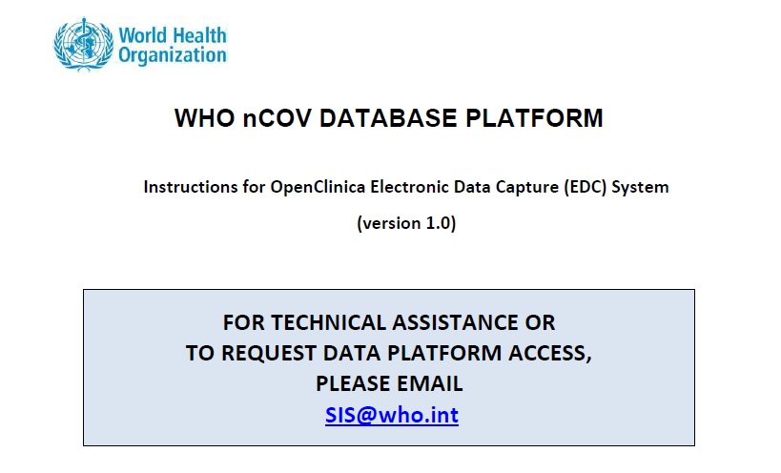
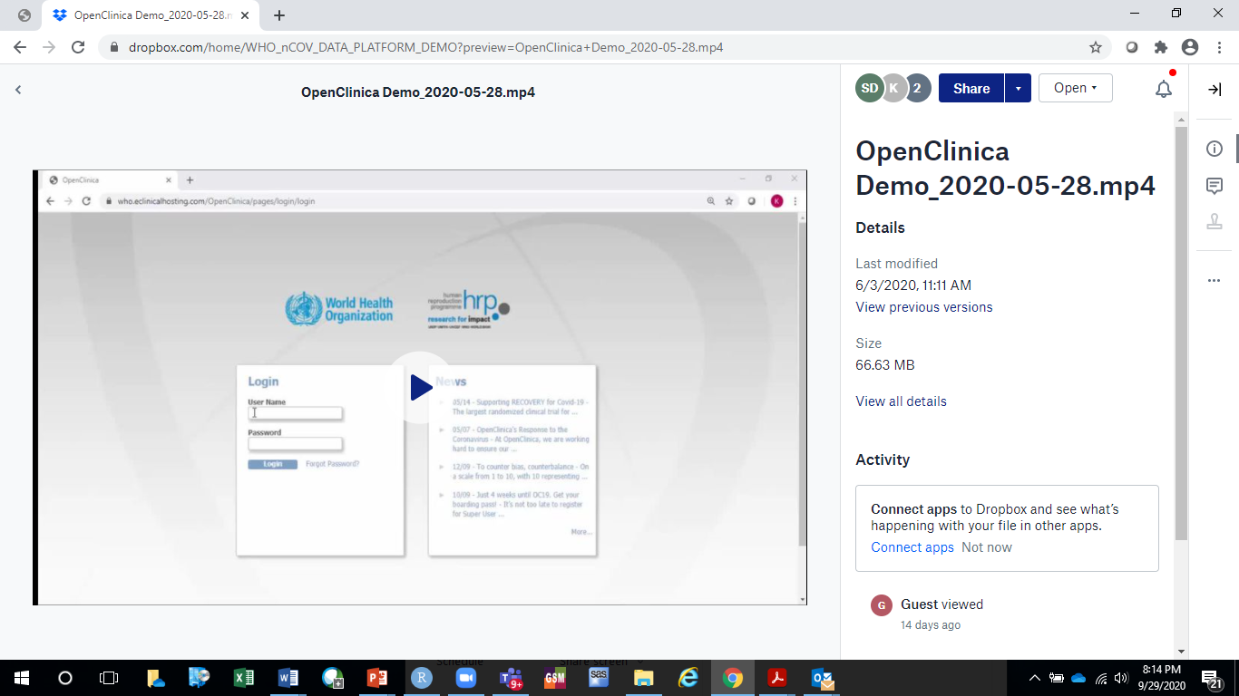
Training & Technical Support
Instruction Manual for Data Platform
Instruction Manual for Data Extraction
Training Video
End-User training via Zoom / Q&A via phone or email

Slide 7
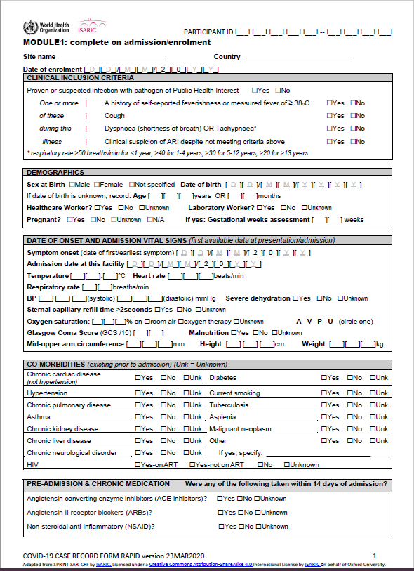
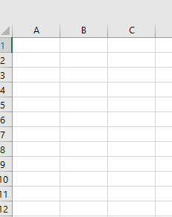
2 options for contributing data to WHO Platform
Pool Data
1) WHO CRF used to collect data
(paper based or electronic)
Web-based System
2) Data entered in local system
Variables aligned and transferred to WHO
WHO work with data contributors to transfer relevant variables from local databases to the WHO COVID-19 Clinical Data Platform

Slide 8
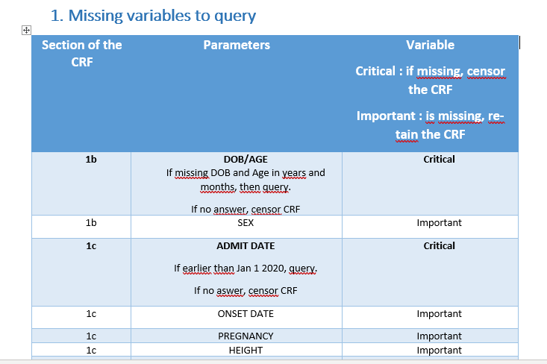
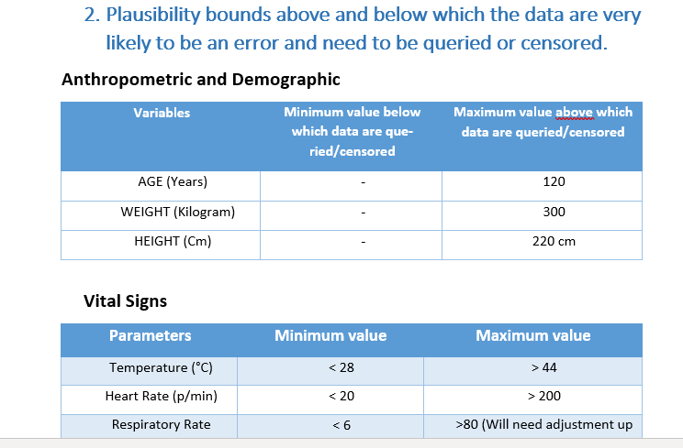
Data Curation
Identify missing key variables (Admission date, Age/DOB)
Identify outliers (demographics, vitals, lab values)
Identify logic discrepancies (parent/child questions, xtabulation)

Slide 9
Thank you.

